Slide 1
WADMIN18-0010 (Art of Childhood)
Washoe County Board of Adjustment
August 2, 2018

Slide 2
Overview
Outdoor Community Event
Fundraiser for Children's Cabinet
August 24th, 4:30 – 8:30 p.m.
Montreux golf course – Third practice hole
Expected attendance - 650 people
Parking at Club House and on De Chardin Ln.

Slide 3
Location
Montreux Golf Course
Third Practice Green
Access from cart path on De Chardin Lane

Slide 4
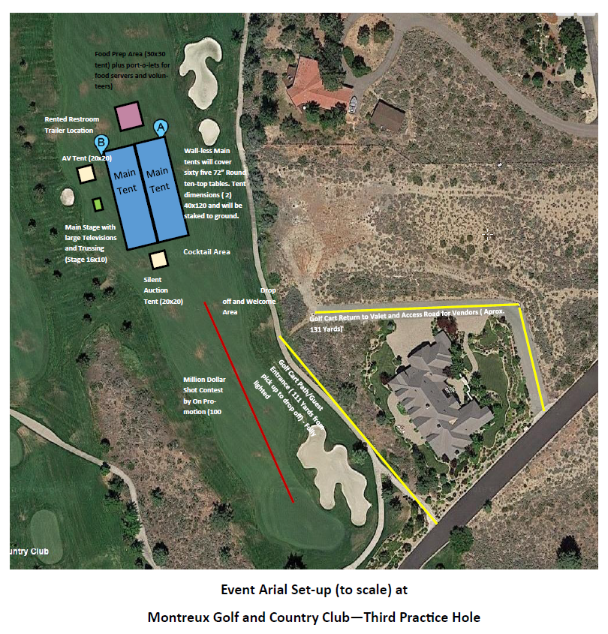
Site Plan

Slide 5
Public Notice and CAB
Notice sent to 126 affected property owners
South Truckee Meadows/Washoe Valley CAB reviewed the application on July 5, 2018
HOA was not told of event or using Montreux Security
Parking and shuttling guest
Recommended approval 3 in favor, 1 opposed

Slide 6
Reviewing Agencies
Washoe County Community Service
Planning and Building Division
Engineering and Capital Projects
Regional Transportation District
Truckee Meadows Fire Protection District
Washoe County Health
Sheriff
Risk Management

Slide 7
Administrative Permit Findings
1. Consistency
2. Improvements
3. Site Suitability
4. Issuance Not Detrimental

Slide 8
Possible Motion
I move that after giving reasoned consideration to the information contained in the staff report and information received during the public hearing, the Board of Adjustment approve with conditions, as attached in Exhibit A of this report, Administrative Permit Case Number WADMIN18-0010 to approve the application for an Outdoor Community Event business license for the Children’s Cabinet, having made all four findings in accordance with Washoe County Development Code Section 110.808.25. I further move to authorize the Director of the Planning and Building Division to issue the license when all pre-event conditions are completed.

